Slide 1

The Impact of Information and Communication Technology ( ICT ) on Modern Businesses
Enhancing Communication, Productivity and Innovation
LAIBA JAMIL
24k-0812

Slide 2
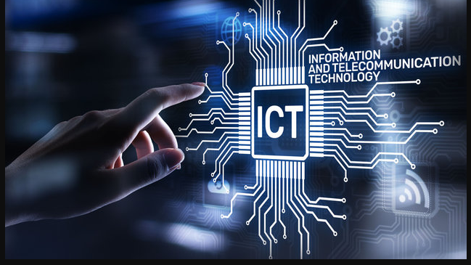
Agenda
Introduction to ICT
Types of ICT Tools and Systems
Importance of ICT in Business
Key ICT Trends and Innovations
Challenges in Implementing ICT
Future of ICT in Business
Conclusion

Slide 3

It combines telecommunications, computing, broadcasting, and audiovisual systems.
Introduction to ICT:
What is ICT?
ICT refers to technologies that provide access to information through telecommunications. It includes the internet, wireless networks, cell phones, and other communication mediums.
Brief History:
The term became widely used in the 1990s….
when communication and computing converged.

Slide 4
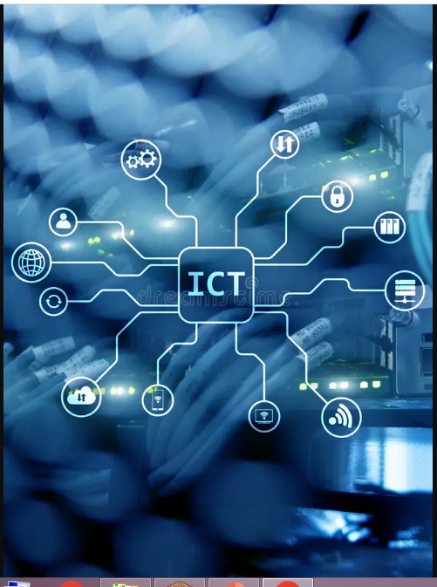
Types of ICT Tools and Systems:
Hardware:
Devices such as computers, servers, routers, switches, and mobile devices. Networking hardware like modems and cables.
2. Software:
Business applications, productivity software, communication platforms, and cloud services.
3. Telecommunication:
Broadband internet, fiber optics, wireless networks, and mobile communication.
4. Networking:
Local Area Networks (LAN), Wide Area Networks (WAN), Virtual Private Networks (VPN), and cloud networking solutions.
5. Data Storage:
Cloud storage, data centers, and decentralized storage systems (e.g., blockchain).

Slide 6


Slide 7


Importance of ICT in Business
Improved Communication:
ICT has transformed communication in businesses. With tools like email, video conferencing, and instant messaging, companies can communicate internally and externally in real time.
Increased Productivity:
ICT enables automation of processes such as inventory management, payroll, and customer relationship management (CRM). This reduces human error and increases efficiency.
Facilitates Innovation:
ICT allows companies to develop new products and services, optimize operations, and access data for better decision-making.
Globalization:
With ICT, businesses can operate globally, collaborate across borders, and access new markets more easily.

Slide 8


Key ICT Trends and Innovations
. Cloud Computing:
What it is: Cloud computing allows data storage, software applications, and computing power to be accessed over the internet.
Impact:
Businesses no longer need to invest heavily in infrastructure; they can scale operations and reduce costs by using cloud services.
Artificial Intelligence (AI) and Machine Learning (ML):Use Case:
AI is being used in customer service (chatbots), predictive analytics, and business intelligence.
Impact:
It automates repetitive tasks and provides insights from large sets of data.
3. Internet of Things (IoT):
What it is: IoT involves connecting everyday objects to the internet (e.g., smart homes, wearable technology).

Slide 9

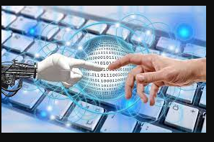
Impact:
Businesses use IoT for monitoring, automation, and predictive maintenance in industries like manufacturing and healthcare.
5G Technology:
What it is: 5G offers higher internet speeds and more reliable connections, enabling advances like autonomous vehicles and smart cities.
Impact:
Businesses can leverage 5G for faster communication, improved customer experience, and remote operations.

Slide 10


Challenges in Implementing ICT
. High Costs:
Initial setup and continuous maintenance can be costly, especially for small and medium-sized enterprises (SMEs).
Cybersecurity Risks:
As businesses increasingly rely on ICT, they become more vulnerable to data breaches and cyberattacks. Securing networks and sensitive data is a major challenge.
Digital Divide:
Not all regions or businesses have equal access to ICT resources. This can widen the gap between tech-advanced companies and those without sufficient infrastructure.
Data Privacy Concerns:
Companies must navigate regulations such as GDPR to protect customer data, which can be complex and expensive to comply with.

Slide 11
Case Study: ICT in E-commerce
Company Example:
Amazon ICT Usage:
Cloud Computing (Amazon Web Services) powers their website and supports millions of transactions.AI and ML for personalized recommendations and demand forecasting.
ICT tools for communication, inventory management, and logistics optimization. Impact on Business:
Enhanced customer experience through fast and efficient service. Reduced operational costs and improved global reach.

